Slide 1
Chapter 9
Mobile Computing and Commerce
and Pervasive Computing

Slide 2
Learning Objectives
Describe the mobile computing environment that supports m-commerce (devices, software, services).
Describe the four major types of wireless telecommunications networks.
Define mobile commerce and understand its relationship to e-commerce.
Discuss the value-added attributes, benefits, and fundamental drivers of m-commerce.
Discuss m-commerce applications in finance, shopping, advertising, and provision of content.
Describe the application of m-commerce within organizations.

Slide 3
Learning Objectives
Understand B2B and supply chain management applications of m-commerce.
Describe consumer and personal applications of m-commerce.
Understand the technologies and potential application of location-based m-commerce.
Describe the major inhibitors and barriers of m-commerce.
Discuss the key characteristics and current uses of pervasive computing.

Slide 4
Mobile Computing:
Content, Infrastructure, and Services
New Computing Environment: Mobile Computing
  Mobile devices
    personal digital assistant (PDA)
    A handheld computer principally used for personal information management
    smartphone
    Internet-enabled cell phone that can support mobile applications
    Blackberry
    A handheld device principally used for e-mail

Slide 5
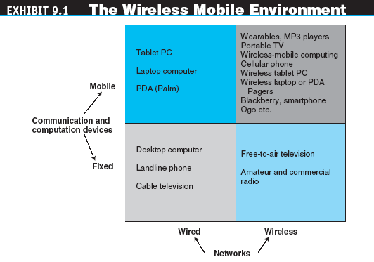
Mobile Computing:
Content, Infrastructure, and Services

Slide 6
Mobile Computing:
Content, Infrastructure, and Services
  Conversion of devices
    These handheld devices blend blogging, Instant Messages, SMS, and other forms of social networking in which Web browsing is easy, especially with a full keyboard
  wireless mobile computing (mobile computing)
  Computing that connects a mobile device to a network or another computing device, anytime, anywhere

Slide 7
Mobile Computing:
Content, Infrastructure, and Services
Enabling Technologies for Mobile Computing
  Hardware and software infrastructures that support the wireless connection include
    Network access points
    Mobile communications server switches
    Cellular transmitters and receivers

Slide 8
Mobile Computing:
Content, Infrastructure, and Services
Mobile Computing Software
  Mobile operating system
  Mobile application user interface
  microbrowser
  Wireless Web browser designed to operate with small screens and limited bandwidth and memory requirements
  Wireless Application Protocol (WAP)
  A suite of network protocols designed to enable different kinds of wireless devices to access WAP readable files on an Internet-connected Web server

Slide 9
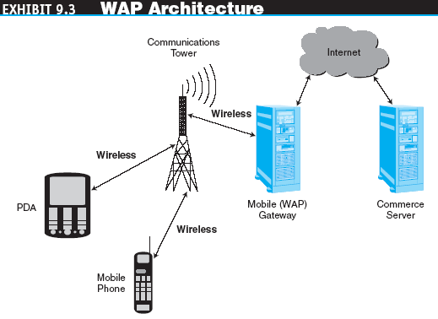
Mobile Computing:
Content, Infrastructure, and Services

Slide 10
Mobile Computing:
Content, Infrastructure, and Services
  Markup languages
    Wireless Markup Language (WML)
    A scripting language used to create content in the WAP environment; based on XML, minus unnecessary content to increase speed
    Compact Hypertext Markup Language (cHTML)
    A scripting language used to create content in
    i-mode

Slide 11
Mobile Computing:
Content, Infrastructure, and Services
  Extensible Hypertext Markup Language (xHTML)
  A general scripting language; compatible with HTML; a standard set by W3 Consortium
  voice XML (VXML)
  An extension of XML designed to accommodate voice

Slide 12
Mobile Computing:
Content, Infrastructure, and Services
  Supporting devices
    synchronization
    The exchange of updated information with other computing devices
    Docking stations
    Attachable keyboards
    Batteries
    Media players

Slide 13
Mobile Computing:
Content, Infrastructure, and Services
Mobile Computing Services
  Short Message Service (SMS)
  A service that supports the sending and receiving of short text messages on mobile phones
  Enhanced Messaging Service (EMS)
  An extension of SMS that can send simple animation, tiny pictures, sounds, and formatted text

Slide 14
Mobile Computing:
Content, Infrastructure, and Services
  Multimedia Messaging Service (MMS)
  The emerging generation of wireless messaging; MMS is able to deliver rich media
  micropayments
  Electronic payments for small-purchase amounts (generally less than $10)

Slide 15
Mobile Computing:
Content, Infrastructure, and Services
  Location-based services
    global positioning system (GPS)
    A worldwide satellite-based tracking system that enables users to determine their position anywhere on the earth
  Voice-support services
    interactive voice response (IVR)
    A voice system that enables users to request and receive information and to enter and change data through a telephone to a computerized system
    voice portal
    A Web site with an audio interface that can be accessed through a telephone call

Slide 16
Wireless Telecommunications Networks
personal area network (PAN)
A wireless telecommunications network for device-to-device connections within a very short range
Bluetooth
A set of telecommunications standards that enables wireless devices to communicate with each other over short distances

Slide 17
Wireless Telecommunications Networks
Wireless Local Area Networks and Wi-fi
  wireless local area network (WLAN)
  A telecommunications network that enables users to make short-range wireless connections to the Internet or another network
  Wi-Fi (wireless fidelity)
  The common name used to describe the IEEE 802.11 standard used on most WLANs

Slide 18
Wireless Telecommunications Networks
  802.11b
  The most popular Wi-Fi standard; it is inexpensive and offers sufficient speed for most devices; however, interference can be a problem
  802.11a
  This Wi-Fi standard is faster than 802.11b but has a smaller range
  802.11g
  This fast but expensive Wi-Fi standard is mostly used in businesses

Slide 19
Wireless Telecommunications Networks
  wireless access point
  An antenna that connects a mobile device to a wired LAN
  hotspot
  An area or point where a wireless device can make a connection to a wireless local area network (using Wi-Fi)

Slide 20
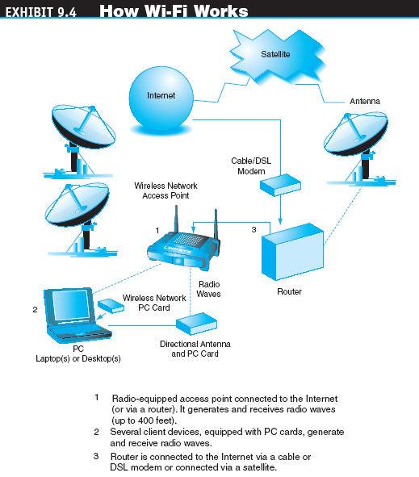
Wireless Telecommunications Networks

Slide 21
Wireless Telecommunications Networks
Municipal Wi-fi Networks
  WiMax
  A wireless standard (IEEE 802.16) for making broadband network connections over a medium size area such as a city
  wireless metropolitan area network (WMAN)
  A telecommunications network that enables users to make medium-range wireless connections to the Internet or another network

Slide 22
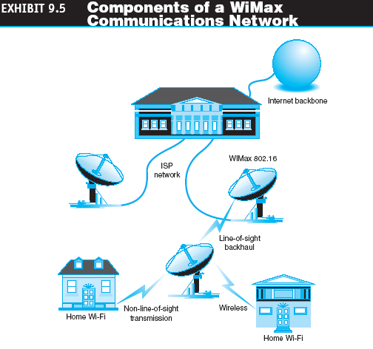
Wireless Telecommunications Networks

Slide 23
Wireless Telecommunications Networks
WIRELESS WIDE AREA NETWORKS
  wireless wide area network (WWAN)
  A telecommunications network that offers wireless coverage over a large geographical area, typically over a cellular phone network
  Physical topology of a WWAN
    subscriber identification module (SIM) card
    An extractable storage card used for identification, customer location information, transaction processing, secure communications, etc.

Slide 24
Wireless Telecommunications Networks
  WWAN communication bandwidths
    1G
    The first generation of wireless technology, which was analog based
    2G
    The second generation of digital wireless technology; accommodates voice and text
    2.5G
    An interim wireless technology that can accommodate voice, text, and limited graphics

Slide 25
Wireless Telecommunications Networks
  3G
  The third generation of digital wireless technology; supports rich media such as video
  3.5G
  This generation was inserted into the ranks of cell phone generations; it refers to the packet-switched technologies used to achieve higher transmission speeds
  4G
  The expected next generation of wireless technology that will provide faster display of multimedia

Slide 26
Wireless Telecommunications Networks
  WWAN communication protocols
    Frequency Division Multiple Access (FDMA)
    Time Division Multiple Access (TDMA)
    Code Division Multiple Access (CDMA)
  WWAN network systems
    Global System for Mobile Communications (GSM)
    An open, nonproprietary standard for mobile voice and data communications

Slide 27
Mobile Commerce:
Attributes, Benefits, and Drivers
mobile commerce (m-commerce,
m-business)
Any business activity conducted over a wireless telecommunications network or from mobile devices
Attributes of M-Commerce
  Ubiquity
  Convenience
  Interactivity
  Personalization
  Localization

Slide 28
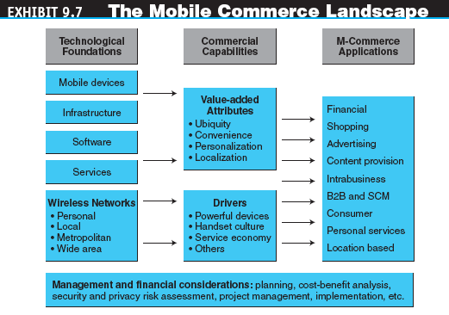
Mobile Commerce:
Attributes, Benefits, and Drivers

Slide 29
Mobile Commerce:
Attributes, Benefits, and Drivers
Drivers of M-Commerce
  Widespread availability of more powerful devices
  The handset culture
  The service economy
  Vendor’s push
  The mobile workforce
  Increased mobility
  Improved price/performance
  Improvement of bandwidth

Slide 30
Mobile Financial Applications
Mobile Banking and Financial Services
  Customers can use their mobile handsets to access account balances, pay bills, and transfer funds using SMS
Wireless Electronic Payment Systems
  Wireless payment systems transform mobile phones into secure, self-contained purchasing support tools capable of instantly authorizing payments over the cellular network
  m-wallet (mobile wallet)
  Technologies that enable cardholders to make purchases with a single click from their wireless device

Slide 31
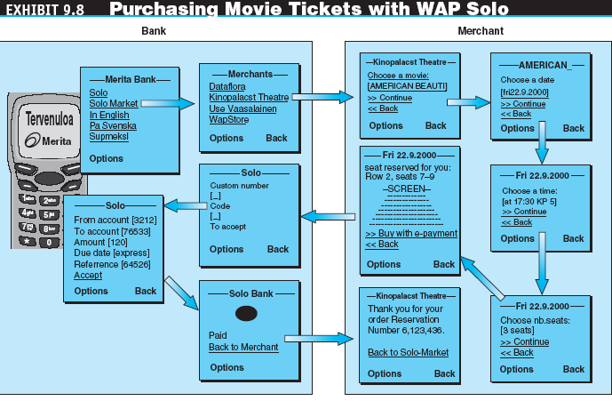
Mobile Financial Applications

Slide 32
Mobile Financial Applications
Wireless Bill Payments
  A number of companies are now providing their customers with the option of paying their bills directly from a cell phone
  Closing the digital divide
    Using WWANs, mobile devices, and even regular cell phones, are closing the digital divide in developing countries such as China, India, and the Philippines

Slide 33
Mobile Shopping,
Advertising, and Content
Wireless Shopping
  An increasing number of online vendors allow customers to shop from wireless devices, especially cell phones and PDAs
Mobile and Targeted Advertising
  Knowing the real-time location of mobile users and their preferences or surfing habits, marketers can send user-specific advertising messages to wireless devices

Slide 34
Mobile Shopping,
Advertising, and Content
mobile portal
A customer interaction channel that aggregates content and services for mobile users

Slide 35
Mobile Enterprise and Supply Chain
Support of Mobile Employees
  Mobile office
  sales force mobilization
  The process of equipping sales force employees with wireless Internet-enabled computing devices
  Worker support in retailing
  Support in hospitals
  Support in operations

Slide 36
Mobile Enterprise and Supply Chain
  Tracking employees
  Job dispatch
  Maintenance and repair at remote sites
  wearable devices
  Mobile wireless computing devices, attached to various parts of employees, for employees who work on buildings and other climbable workplaces

Slide 37
Mobile Enterprise and Supply Chain
Supporting Other Types of Work
Customer and Partner Support
Non–Internet Enterprise Applications
B2B M-Commerce and Supply Chain Management

Slide 38
Mobile Personal and Consumer Service Applications
Mobile Entertainment
  Mobile games and gambling
  Hands-free driving
Wireless Telemedicine
Other Mobile Computing Services for Consumers
Non–Internet Mobile Applications for Consumers

Slide 39
Location-Based Mobile Commerce
location-based m-commerce (l-commerce)
Delivery of m-commerce transactions to individuals in a specific location, at a specific time
The services provided through location-based m-commerce focus on five key factors:
  Location
  Navigation
  Tracking
  Mapping
  Timing

Slide 40
Location-Based Mobile Commerce
The Technology For L-Commerce
  Global positioning system
  geographical information system (GIS)
  A computer system capable of integrating, storing, editing, analyzing, sharing, and displaying geographically-referenced (spatial) information
  GPS/GIS applications

Slide 41
Location-Based Mobile Commerce
Location-Based Advertising
Emergency Response Cell Phone Calls
    wireless 911 (e-911)
    In the United States, emergency response system that processes calls from cellular phones
    automatic crash notification (ACN)
    Device that automatically sends the police the location of a vehicle that has been involved in a crash

Slide 42
Location-Based Mobile Commerce
telematics
The integration of computers and wireless communications to improve information flow using the principles of telemetry
Other Applications of Location-Based Systems

Slide 43
Location-Based Mobile Commerce
Barriers to Location-Based
M-Commerce
  Accuracy of devices
  The cost-benefit justification
  Limited network bandwidth
  Invasion of privacy

Slide 44
Security and Other
Implementation Issues in M-Commerce
M-Commerce Security Issues
  Malicious codes
  Transaction security
  Wireless communication
  Physical security of mobile devices
  Ease of use and poor security
  Security measures

Slide 45
Security and Other
Implementation Issues in M-Commerce
Technological Barriers to
M-Commerce
  Many Web sites are not designed for viewing by mobile devices
  Current devices have limited usability, particularly with respect to pocketsize screens or data input devices
  Quick and easy navigation of sites is necessary but not always available in the mobile environment

Slide 46
Security and Other
Implementation Issues in M-Commerce
Ethical, Legal, and Health Issues in M-Commerce
Barriers for Enterprise Mobile Computing
Project Failures in M-Commerce

Slide 47
Pervasive Computing
pervasive computing
Invisible, everywhere computing that is embedded in the objects around us
  Invisible computing
  Principles of pervasive computing
    Decentralization
    Diversification
    Connectivity
    Simplicity

Slide 48
Pervasive Computing
contextual computing
The enhancement of a user’s interactions by understanding the user, the context, and the applications and information required
radio frequency identification (RFID)
Technology that uses radio waves to identify items

Slide 49
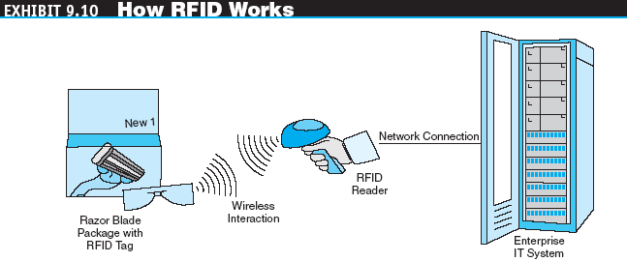
Pervasive Computing

Slide 50
Pervasive Computing
  RFID Applications
    Track moving vehicles
    Track people
    Track individual items
    Protect secure areas
    Record transactions
  Electronic Product Code (EPC)
  An RFID code that identifies the manufacturer, producer, version, and serial number of individual consumer products

Slide 51
Pervasive Computing
Smart Applications: Homes, Cars, and More
  Smart homes
    Lighting
    Energy management
    Water control
    Home security and communications
    Home entertainment

Slide 52
Pervasive Computing
  Smart cars
  sensor network
  A series of interconnected sensors that monitor the environment in which they are placed
Barriers to Pervasive Computing
  A number of technological, legal, and ethical issues still need to be fully explored and resolved if the promises of pervasive computing are to be realized

Slide 53
Managerial Issues
What’s our timetable?
Which applications first?
Is it real or just a buzzword?
Which system to use?
Is an all-in-one device a winner?
Which will win the wireless race: WiMax, Wi-Fi, or 3G?

